Slide 1
Counting

Slide 2
The basics of counting (§6.1)
Let m be the number of ways to do task 1 and n the number of ways to do task 2,
with each number independent of how the other task is done,
and also assume that no way to do task 1 simultaneously also accomplishes task 2.
Then, we have the following rules:
The sum rule: The task “do either task 1 or task 2, but not both” can be done in m+n ways.
The product rule: The task “do both task 1 and task 2” can be done in mn ways.

Slide 3
Set Theoretic Version
If A is the set of ways to do task 1, and B the set of ways to do task 2, and if A and B are disjoint, then:
The ways to do either task 1 or 2 are A∪B, and |A∪B|=|A|+|B|
The ways to do both task 1 and 2 can be represented as A×B, and |A×B|=|A|·|B|

Slide 4
Extended multiple rules
Suppose that tasks T₁, T₂, . . . , T_{k} are to be performed in sequence. If T₁ can be performed in n₁ ways, and for each of these ways T₂ can be performed in n₂ ways, and for each of these n₁n₂ ways of performing T₁T₂ in sequence, T₃ can be performed in n₃ ways, and so on, then the sequence T₁T₂ . . .T_{k} can be performed in exactly n₁n₂ . . .n_{k} ways.

Slide 5
Example
A label identifier, for a computer system, consists of one letter followed by three digits. If repetitions are allowed, how many distinct label identifiers are possible?
Solution
There are 26 possibilities for the beginning letter and there are 10 possibilities for each of the three digits.
Thus, by the extended multiplication principle, there are 26×10 ×10 ×10 or 26,000 possible label identifiers.

Slide 6
Example
Let A be a set with n elements. How many subsets does A have?
Solution: 2^{n}
When the elements of A are listed in an arbitrary order, there is a one-to-one correspondence between subsets of A and bit strings of length |A|. When the ith element is in the subset, the bit string has a 1 in the ith position and a 0 otherwise.
By the product rule, there are 2^{|A|} such bit strings, and therefore 2^{|A|} subsets.

Slide 7
Example
Let A be any set with n elements, and suppose that l ≤ r ≤ n.
Problem 1
How many different sequences, each of length r, can be formed using elements from A if
(a) elements in the sequence may be repeated?
(b) all elements in the sequence must be distinct?

Slide 8

First we note that any sequence of length r can be formed by filling r boxes in order from left to right with elements of A.
In case (a) we may use copies of elements of A.
Let T₁ be the task “fill box 1” let T₂be the task “fill box 2” and so on.
Then the combined task T₁T₂ . . . T_{r} represents the formation of the sequence.

Slide 9
Case (a). T₁ can be accomplished in n ways, since we may copy any element of A for the first position of the sequence.
The same is true for each of the tasks T₂ , T₃ ,…,T_{r} .
Then by the extended multiplication principle, the number of sequences that can be formed is n • n •... • n=n^{r} .

Slide 10
Theorem
Let A be a set with n elements and l≤r≤n . Then the number of sequences of length r that can be formed from elements of A, allowing repetitions, is n^{r}.

Slide 11
Now we consider case (b) of Problem 1.
T₁ can be performed in n ways, since any element of A can be chosen for the first position.
Whichever element is chosen, only (n - 1) elements remain, so that T₂ can be performed in(n - l) ways, and so on, until finally T_{r} can be performed in n - (r - 1)) or (n - r + 1) ways.
Thus, by the extended principle of multiplication, a sequence of r distinct element from A can be formed in n(n - l)(n - 2) … (n - r +1) ways.

Slide 12
Counting Functions
Counting Functions: How many functions are there from a set with m elements to a set with n elements?
Solution: Since a function represents a choice of one of the n elements of the codomain for each of the m elements in the domain, the product rule tells us that there are n ∙ n ∙ ∙ ∙ n = n^{m} such functions.
Counting One-to-One Functions: How many one-to-one functions are there from a set with m elements to one with n elements?
Solution: Suppose the elements in the domain are a₁, a₂,…, a_{m}. There are n ways to choose the value of a₁ and n−1 ways to choose a₂, etc. The product rule tells us that there are n(n−1) (n−2)∙∙∙(n−m +1) such functions.

Slide 13
IP Address Example
Some facts about the Internet Protocol, version 4:
Valid computer addresses are in one of 3 types:
A class A IP address contains a 7-bit “netid” ≠ 1⁷, and a 24-bit “hostid”
A class B address has a 14-bit netid and a 16-bit hostid.
A class C addr. Has 21-bit netid and an 8-bit hostid.
The 3 classes have distinct headers (0, 10, 110)
Hostids that are all 0s or all 1s are not allowed.
How many valid computer addresses are there?
e.g., ufl.edu is 128.227.74.58
e.g., www.bupt.edu.cn is 211.68.69.240

Slide 14
IP address solution
(# addrs) = (# class A) + (# class B) + (# class C)
(by sum rule)
# class A = (# valid netids)·(# valid hostids)
(by product rule)
(# valid class A netids) = 2⁷ − 1 = 127.
(# valid class A hostids) = 2²⁴ − 2 = 16,777,214.
Continuing in this fashion we find the answer is: 3,737,091,842 (3.7 billion IP addresses)

Slide 15
Subtraction Rule (Inclusion-Exclusion )
Suppose that k≤m of the ways of doing task 1 also simultaneously accomplish task 2.
And thus are also ways of doing task 2.
Then, the number of ways to accomplish “Do either task 1 or task 2” is m+n−k.
Set theory: If A and B are not disjoint, then |A∪B|=|A|+|B|−|A∩B|.
If they are disjoint, this simplifies to |A|+|B|.

Slide 16
Inclusion/Exclusion Example
Some hypothetical rules for passwords:
Passwords must be 2 characters long.
Each character must be a letter a-z, a digit 0-9, or one of the 10 punctuation characters !@#$%^&*().
Each password must contain at least 1 digit or punctuation character.

Slide 17
Setup of Problem
A legal password has a digit or puctuation character in position 1 or position 2.
These cases overlap, so the principle applies.
(# of passwords w. OK symbol in position #1) = (10+10)·(10+10+26)
(# w. OK sym. in pos. #2): also 20·46
(# w. OK sym both places): 20·20
Answer: 920+920−400 = 1,440

Slide 18
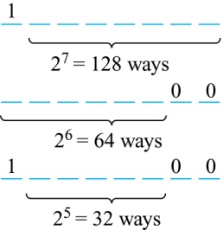
Counting Bit Strings
Example: How many bit strings of length eight either start with a 1 bit or end with the two bits 00?
Solution: Use the subtraction rule.
Number of bit strings of length eight that start with a 1 bit: 2⁷ = 128
Number of bit strings of length eight that start with bits 00: 2⁶ = 64
Number of bit strings of length eight that start with a 1 bit and end with bits 00 : 2⁵ = 32
Hence, the number is 128 + 64 − 32 = 160.

Slide 19
Division Rule
There are n/d ways to do a task if it can be done using a procedure that can be carried out in n ways, and for every way w, exactly d of the n ways correspond to way w.
If the finite set A is the union of n pairwise disjoint subsets each with d elements, then n = |A|/d.
If f is a function from A to B where A and B are finite sets, and that for every value y ∈ B there are exactly d values x ∈ A such that f (x) = y, then |B| = |A|/d

Slide 20
Example
How many different ways are there to seat four people around a circular table, where two seatings are considered the same when each person has the same left neighbor and the same right neighbor?
Solution: Number the seats around the table from 1 to 4 proceeding clockwise. There are four ways to select the person for seat 1, 3 for seat 2, 2, for seat 3, and one way for seat 4. Thus there are 4! = 24 ways to order the four people. But since two seatings are the same when each person has the same left and right neighbor, for every choice for seat 1, we get the same seating.
Therefore, by the division rule, there are 24/4 = 6 different seating arrangements.

Slide 21
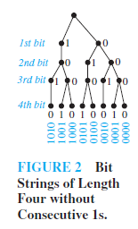
Tree Diagrams
Example
How many bit strings of length four do not have two consecutive 1s?

Slide 22
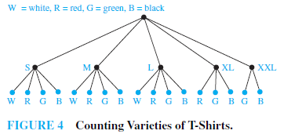
Example
Suppose that T-shirts come in five different sizes: S, M, L, XL, and XXL.
Further suppose that each size comes in four colors, white, red, green, and black, except for XL,which comes only in red, green, and black, and XXL, which comes only in green and black.
How many different shirts does a souvenir shop have to stock to have at least one of each available size and color of the T-shirt?

Slide 23
Homework
§6.1
48, 52

Slide 24
Pigeonhole Principle (§6.2)
A.k.a. the “Dirichlet drawer principle”
If ≥k+1 objects are assigned to k places, then at least 1 place must be assigned ≥2 objects.
In terms of the assignment function:
If f:A→B and |A|≥|B|+1, then some element of B has ≥2 preimages under f.
I.e., f is not one-to-one.

Slide 25
Example of Pigeonhole Principle
There are 101 possible numeric grades (0%-100%) rounded to the nearest integer.
Also, there are >101 students in this class.
Therefore, there must be at least one (rounded) grade that will be shared by at least 2 students at the end of the semester.
I.e., the function from students to rounded grades is not a one-to-one function.

Slide 26
Fun Pigeonhole Proof
Theorem: ∀n∈N, ∃ a multiple m>0 of n, m has only 0’s and 1’s in its decimal expansion!
Proof: Consider the n+1 decimal integers 1, 11, 111, …, 1☹1. They have only n possible
residues mod n. So, take the difference of two that have the same residue. The result is the answer!
n+1
a≡b (mod n) iff n|a−b

Slide 27
A Specific Case
Let n=3. Consider 1, 11, 111, 1111.
1 mod 3 = 1
11 mod 3 = 2
111 mod 3 = 0 ⬅ Lucky extra solution.
1,111 mod 3 = 1
1,111 − 1 = 1,110 = 3·370.
It has only 0’s and 1’s in its expansion.
Its residue mod 3 = 0, so it’s a multiple of 3.
Note same residue.

Slide 28
Another Fun Example
Suppose that next June, the Marlins baseball team plays at least 1 game a day, but ≤45 games total. Show there must be some sequence of consecutive days in June during which they play exactly 14 games.
Proof: Let a_{j} be the number of games played on or before day j.
Then, a₁,…,a₃₀ ∈ Z⁺ is a sequence of 30 distinct integers with 1 ≤ a_{j} ≤ 45.
Therefore a₁+14,…,a₃₀+14 is a sequence of 30 distinct integers with 15 ≤ a_{j}+14 ≤ 59.
Thus, (a₁,…,a₃₀,a₁+14,…,a₃₀+14) is a sequence of 60 integers from the set {1,..,59}. By the Pigeonhole Principle, two of them must be equal, but a_{i}≠a_{j} for i≠j. So, ∃ij: a_{i} = a_{j}+14. Thus, 14 games were played on days a_{j}+1, …, a_{i}.

Slide 29
Baseball problem illustrated
Example of {a_{i}}: Note all elements are distinct.
1, 2, 4, 5, 7, 8, 10, 11, 13, 14, 16, 17, 19, 21, 22, 23, 25, 27, 29, 30, 31, 33, 34, 36, 37, 39, 40, 41, 43, 45
Then {a_{i}+14} is the following sequence: 15, 16, 18, 19, 21, 22, 24, 25, 27, 28, 30, 32, 33, 35, 36, 37, 39, 41, 43, 44, 45, 47, 48, 50, 51, 53, 54, 55, 57, 59
In any 60 integers from 1-59 there must be some duplicates, indeed we find the following ones:
16, 19, 21, 22, 25, 27, 30, 33, 36, 37, 39, 41, 43, 45
Thus, for example, exactly 14 games were played during days 3 to 11: 2+1+2+1+2+1+2+1+2

Slide 30
Generalized Pigeonhole Principle
If N objects are assigned to k places, then at least one place must be assigned at least ⎡N/k⎤ objects.
E.g., there are N=280 students in this class. There are k=52 weeks in the year.
Therefore, there must be at least 1 week during which at least ⎡280/52⎤= ⎡5.38⎤=6 students in the class have a birthday.

Slide 31
Proof of G.P.P.
By contradiction. Suppose every place has < ⎡N/k⎤ objects, thus ≤ ⎡N/k⎤−1.
Then the total number of objects is at most
So, there are less than N objects, which contradicts our assumption of N objects!

Slide 32
G.P.P. Example
Given: There are 280 students in the class.
Without knowing anybody’s birthday, what is the largest value of n for which we can prove using the G.P.P. that at least n students must have been born in the same month?
Answer:
⎡280/12⎤ = ⎡23.3⎤ = 24

Slide 33
Example 7
How many cards must be selected from a standard deck of 52 cards to guarantee that at least three cards of the same suit are chosen?
How many must be selected to guarantee that at least three hearts are selected?
Solution: At least three cards of one suit are selected if ⌈N/4⌉ ≥3. The smallest integer N such that ⌈N/4⌉ ≥3 is N = 2 ∙ 4 + 1 = 9.
A deck contains 13 hearts and 39 cards which are not hearts. when we select 42 cards, we must have at least three hearts. (Note that the generalized pigeonhole principle is not used here.)

Slide 34
Example 11
Show that among any n+1 positive integers not exceeding 2n there must be an integer that divides one of the other integers.
Proof:
Each of the n+1 integers a₁, a₂, … , a_{n+1} can be written as a power of 2 times an odd integer. (why?)
In other words, let a_{j} = 2^{kj}q_{j} for j = 1, 2,…, n+1, where k_{j} is a nonnegative integer and all q_{j} are odd positive integers less than 2n.
Because there are only n odd positive integers less than 2n, it follows from the pigeonhole principle that two of the integers q₁, q₂, … , q_{n+1} must be equal.
Therefore, there are distinct integers i and j such that q_{i} = q_{j} = q. Then, a_{i} = 2^{ki}q and a_{j} = 2^{kj}q. It follows that if k_{i} < k_{j} , then a_{i} divides a_{j} ; while if k_{i} > k_{j} , then a_{j} divides a_{i} .

Slide 35
Mathematical induction
The base case is n = 1. a set of two elements from {1, 2}.
Assume the inductive hypothesis p(n):among any n+1 positive integers not exceeding 2n there must be an integer that divides one of the other integers.
consider a set A of n + 2 elements from {1, 2, . . . , 2n, 2n + 1, 2n+2}.
If n+1 of the elements of A are less than 2n + 1,we get the conclusion.
assume that both 2n + 1 and 2n + 2 are in A, together with n smaller elements.
If n + 1 ∈A, then we are done, since n + 1 | 2n + 2.
So we can assume that n + 1∉ A.
B = A − {2n + 1, 2n + 2} ∪ {n + 1}.
Since B is a collection of n + 1 numbers from {1, 2, . . . , 2n}, one element of B divides another.
If n + 1 is not one of these two numbers, then we are done.
assume n + 1 is one of these two numbers. Certainly n + 1 can’t be the divisor, since its smallest multiple is too big to be in B, so there is some k ∈ B that divides n + 1. But now k and 2n + 2 are numbers in A, with k dividing n + 2, and we are done.

Slide 36
Suppose that a₁,a₂,…a_{n} is a sequence of real numbers. A subsequence of this sequence is a sequence of the form a_{i1},a_{i2},…a_{im} ,where 1≤ i₁<i₂<…<i_{m} ≤N.
A sequence is called strictly increasing if each term is larger than the one that precedes it.
A sequence is called strictly decreasing if each term is smaller than the one that precedes it.

Slide 37
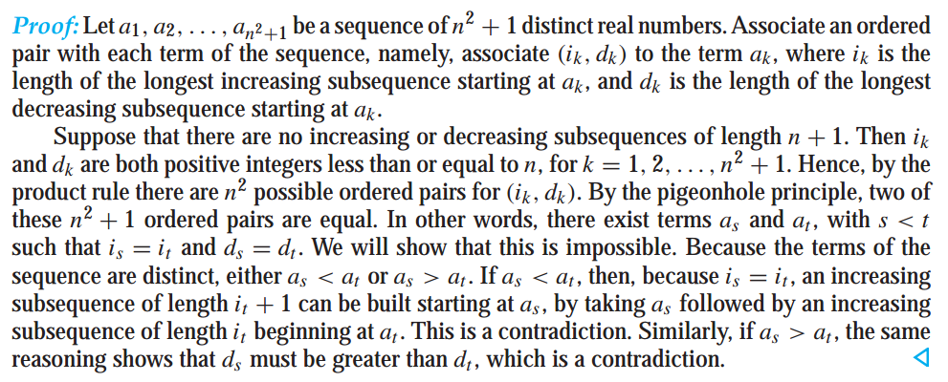
Theorem 3
Every sequence of n²+1 distinct real number contains a subsequence of length n+1 that is either strictly increasing or strictly decreasing.

Slide 38
Ramsey theory (拉姆齐理论)
Example 13
Assume that in a group of six people, each pair of individuals consists of two friends or two enemies. Show that there are either three mutual friends or three mutual enemies in the group.
Proof
Let A be one of the six people. Of the five other people in the group, there are either three or more who are friends of A, or three or more who are enemies of A. This follows from the generalized pigeonhole principle, because when five objects are divided into two sets, one of the sets has at least ⌈5∕2⌉ = 3 elements.
In the former case, suppose that B, C, and D are friends of A. ①If any two of these three individuals are friends, then these two and A form a group of three mutual friends. ②Otherwise, B, C, and D form a set of three mutual enemies.
The proof in the latter case, when there are three or more enemies of A, proceeds in a similar manner.
Notes:
拉姆齐理论（英国数学家）

Slide 39
Homework
§6.2
14, 28, 48

Slide 40
Permutations (§6.3)
A permutation of a set S of objects is a sequence that contains each object in S exactly once.
An ordered arrangement of r distinct elements of S is called an r-permutation of S.
The number of r-permutations of a set with n=|S| elements is P(n,r) = n(n−1)…(n−r+1) = n!/(n−r)!

Slide 41
Permutation Example
A terrorist has planted an armed nuclear bomb in your city, and it is your job to disable it by cutting wires to the trigger device. There are 10 wires to the device. If you cut exactly the right three wires, in exactly the right order, you will disable the bomb, otherwise it will explode! If the wires all look the same, what are your chances of survival?
P(10,3) = 10·9·8 = 720, so there is a 1 in 720 chance that you’ll survive!

Slide 42
Solving Counting Problems by Counting Permutations
Example: How many ways are there to select a first-prize winner, a second prize winner, and a third-prize winner from 100 different people who have entered a contest?
Solution:
P(100,3) = 100 ∙ 99 ∙ 98 = 970,200

Slide 43
Solving Counting Problems by Counting Permutations (continued)
Example: Suppose that a saleswoman has to visit eight different cities. She must begin her trip in a specified city, but she can visit the other seven cities in any order she wishes. How many possible orders can the saleswoman use when visiting these cities?
Solution: The first city is chosen, and the rest are ordered arbitrarily. Hence the orders are:
7! = 7 ∙ 6 ∙ 5 ∙ 4 ∙ 3 ∙ 2 ∙ 1 = 5040
If she wants to find the tour with the shortest path that visits all the cities, she must consider 5040 paths!

Slide 44
Solving Counting Problems by Counting Permutations (continued)
Example: How many permutations of the letters ABCDEFGH contain the string ABC ?
Solution: We solve this problem by counting the permutations of six objects, ABC, D, E, F, G, and H.
6! = 6 ∙ 5 ∙ 4 ∙ 3 ∙ 2 ∙ 1 = 720

Slide 45
Combinations (§6.3)
An r-combination of elements of a set S is simply a subset T⊆S with r members, |T|=r.
The number of r-combinations of a set with n=|S| elements is
Note that C(n,r) = C(n, n−r)
Because choosing the r members of T is the same thing as choosing the n−r non-members of T.

Slide 46
Combination Example
How many distinct 7-card hands can be drawn from a standard 52-card deck?
The order of cards in a hand doesn’t matter.
Answer C(52,7) = P(52,7)/P(7,7) = 52·51·50·49·48·47·46 / 7·6·5·4·3·2·1
52·17·10·7·47·46 = 133,784,560

Slide 47
Homework
§6.3
30, 46

Slide 48
Generalized Permutations and Combinations
Permutation with repetition
Theorem 1
The number of r-permutations of a set of n objects with repetition allowed is n^{r}.
How many strings of length r can be formed from the uppercase letters of the English alphabet?

Slide 49
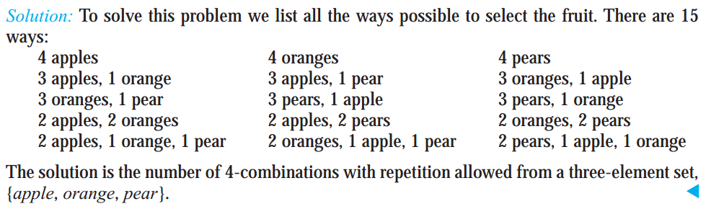
Combinations with repetition
Example 2
How many ways are there to select four pieces of fruit from a bowl containing apples ,oranges, and pears if the order in which the pieces are selected does not matter, only the type of fruit and not the individual piece matters, and there are at least four pieces of each type of fruit in the bowl?

Slide 50
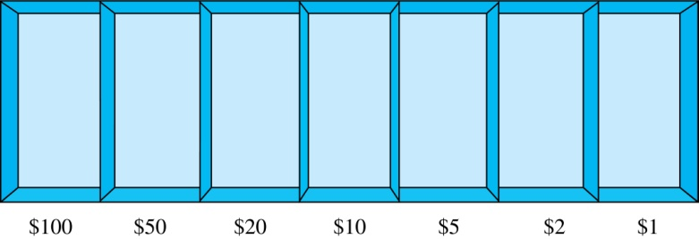
Combinations with Repetition
Example: How many ways are there to select five bills from a box containing at least five of each of the following denominations: $1, $2, $5, $10, $20, $50, and $100?
Solution: Place the selected bills in the appropriate position of a cash box illustrated below:
continued →

Slide 51
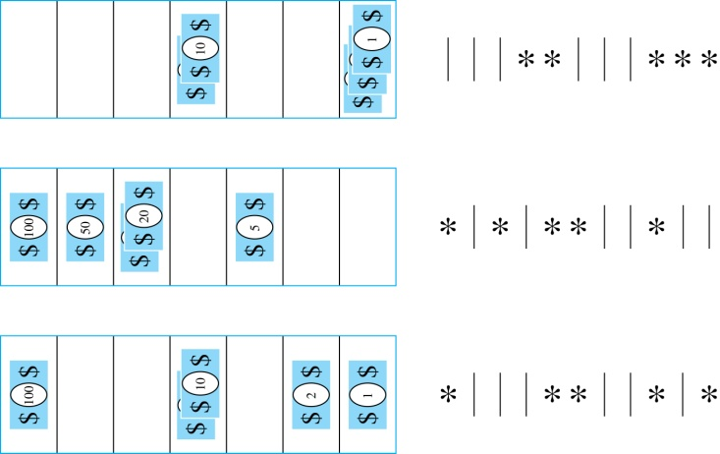

Combinations with Repetition
Some possible ways of
placing the five bills:
The number of ways to select five bills corresponds to the number of ways to arrange six bars and five stars in a row.
This is the number of unordered selections of 5 objects from a set of 11. Hence, there are
ways to choose five bills with seven types of bills.

Slide 52
Combinations with Repetition
Theorem 2: The number of r-combinations from a set with n elements when repetition of elements is allowed is
C(n + r – 1,r) = C(n + r – 1, n –1).
Proof: Each r-combination of a set with n elements with repetition allowed can be represented by a list of n –1 bars and r stars. The bars mark the n cells containing a star for each time the ith element of the set occurs in the combination.
The number of such lists is C(n + r – 1, r), because each list is a choice of the r positions to place the stars, from the total of n + r – 1 positions to place the stars and the bars. This is also equal to C(n + r – 1, n –1), which is the number of ways to place the n –1 bars.

Slide 53
Combinations with Repetition
Example: How many solutions does the equation
x₁ + x₂ + x₃ = 11
have, where x₁ , x₂ and x₃ are nonnegative integers?
x1≥1, x2≥2, x3≥3.
Solution: Each solution corresponds to a way to select 11 items from a set with three elements; x₁ elements of type one, x₂ of type two, and x₃ of type three.
By Theorem 2 it follows that there are
solutions.
C(3+5-1,5)=C(7,2)

Slide 54
Combinations with Repetition
Example: Suppose that a cookie shop has four different kinds of cookies. How many different ways can six cookies be chosen?
Solution: The number of ways to choose six cookies is the number of 6-combinations of a set with four elements. By Theorem 2
is the number of ways to choose six cookies from the four kinds.

Slide 55
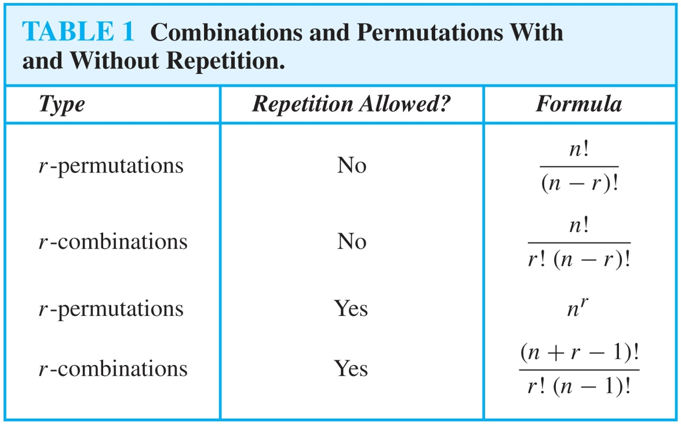
Summarizing the Formulas for Counting Permutations and Combinations with and without Repetition

Slide 56
Permutations with Indistinguishable Objects
Example: How many different strings can be made by reordering the letters of the word SUCCESS.
Solution: There are seven possible positions for the three Ss, two Cs, one U, and one E.
The three Ss can be placed in C(7,3) different ways, leaving four positions free.
The two Cs can be placed in C(4,2) different ways, leaving two positions free.
The U can be placed in C(2,1) different ways, leaving one position free.
The E can be placed in C(1,1) way.
By the product rule, the number of different strings is:
The reasoning can be generalized to the following theorem. →

Slide 57
Permutations with Indistinguishable Objects
Theorem 3
The number of different permutations of n objects, where there are n_{l} indistinguishable objects of type 1, n₂ indistinguishable objects of type 2,…and n_{k} indistinguishable objects of type k, is

Slide 58
Proof: By the product rule the total number of permutations is:
C(n, n₁ ) C(n − n₁, n₂ ) ∙∙∙ C(n − n₁ − n₂ − ∙∙∙ − n_{k}, n_{k}) since:
The n₁ objects of type one can be placed in the n positions in C(n, n₁ ) ways, leaving n − n₁ positions.
Then the n₂ objects of type two can be placed in the n − n₁ positions in C(n − n₁, n₂ ) ways, leaving n − n₁ − n₂ positions.
Continue in this fashion, until n_{k} objects of type k are placed in
C(n − n₁ − n₂ − ∙∙∙ − n_{k}, n_{k}) ways.
The product can be manipulated into the desired result as follows:

Slide 59
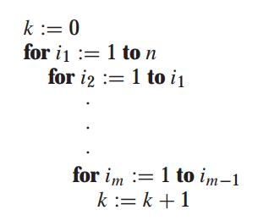


Example 6
What is the value of k after the followimg pseudocode has been executed?

Slide 60
Distributing Objects into Boxes
Many counting problems can be solved by counting the ways objects can be placed in boxes.
The objects may be either different from each other (distinguishable) or identical (indistinguishable).
The boxes may be labeled (distinguishable) or unlabeled (indistinguishable).

Slide 61
Distinguishable objects and distinguishable boxes
Theorem 4
The number of ways to distribute n distinguishable objects into k distinguishable boxes so that n_{i} objects are placed into box i,i=1,2,…k, equals

Slide 62
Distinguishable objects and distinguishable boxes
Example 8
How many ways are there to distribute hands of 5 cards to each of four players from the standard deck of 52 cards?
There are 52!/(5!5!5!5!32!) ways to distribute hands of 5 cards each to four players.

Slide 63
Indistinguishable objects and distinguishable boxes.
There are C(n + r − 1, n − 1) ways to place r indistinguishable objects into n distinguishable boxes.
Proof based on one-to-one correspondence between n-combinations from a set with k-elements when repetition is allowed and the ways to place n indistinguishable objects into k distinguishable boxes.

Slide 64
Indistinguishable objects and distinguishable boxes.
Example 9
How many ways are there to place 10 indistinguishable balls into 8 distinguishable bins?
There are C(8 + 10 − 1, 10) = C(17,10) = 19,448 ways to place 10 indistinguishable objects into 8 distinguishable boxes.

Slide 65
Homework
§6.5
14, 20, 36, 48

